Slide 1
Welcome to 4th Grade!
Have you signed in online?
If not, please visit the 4th grade hallway to sign in at NateMack4.weebly.com

Slide 2
Meet the Teachers
Mrs. Hinton
Math
9th year teaching in CCSD
7th year teaching at Nate Mack
6th year in 4th grade
Product of CCSD
Graduated from UNLV
Mrs. Rozgay-Miller
Informational Reading and Writing / Science and Social Studies
10th year teaching in CCSD
10th year teaching 4th grade at Nate Mack
Mr. Probert
Literature Reading and Writing / Grammar and Language
24th year teaching in CCSD
23 years in 3rd grade
Each subject is 80 minutes long
Homeroom is for attendance and report cards only. Students will spend an equal amount of time with each teacher in each subject area.
For questions or concerns please email the subject teacher.

Slide 3
READING GRADES
WRITING GRADES
Research Papers
Fictional Pieces (Narratives)
Opinion Writing

Slide 4
MATH GRADES

Slide 5
Quiz
Given after practicing a standard in class Considered practice for the final test
If a student does not show mastery of a practiced standard (70% or higher), they may RETAKE the quiz after more practice.
Test Given at the end of a unit. Include multiple standards Often be worth multiple grades. Students may NOT retake a test.
Students are encouraged to retake quizzes if needed to ensure they are ready for the final test.

Slide 6
RETESTING POLICY
Mastery Level – 70%
Reassessments can be taken on math, science, social studies, or grammar quizzes. Reading assignments may not be retaken as the standards are practiced year round – new grades will replace older grades.
In order to retest, students must:
Get a practice sheet(s) from the teacher
Complete practice sheet on their own time
Earn at least a 90% on the practice
Make an appointment to requiz

Slide 7
Reading Homework
Oral Book Reviews
Students will present an oral book review once per month. Each student will be assigned a day to present.
Students may choose their own books at their reading level.
Students will alternate between fiction and non-fiction books each month.
Oral book reviews will be presented during Literature or Informational reading classes.
OPTIONAL Battle of the Books Read 7 of 10 books from the approved list / Pass AR quiz 80% / Challenge competition in Spring

Slide 8
Math Homework
Mixed Review (daily worksheet) – 4 random concept math questions
Content Practice (daily worksheet) – Practice of concepts taught in class
XtraMath (every other week online) – Multiplication Fact practice to be completed 3 times a week
ScootPad (every other week online) – Differentiated Practice based on student learning path

Slide 9
Grammar Homework
Content Practice (worksheet AS NEEDED) – Practice of concepts taught in class
ScootPad (every week online) – Online practice of skills learned in class

Slide 10
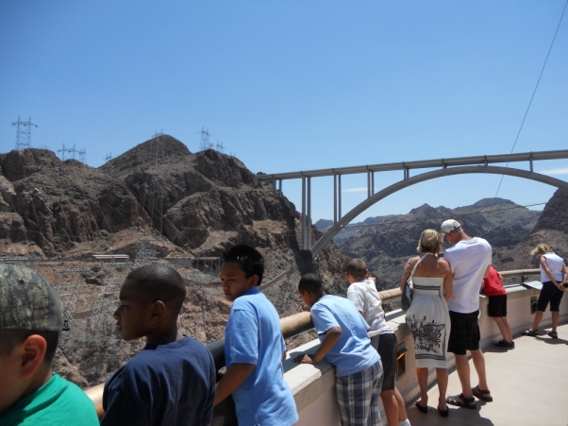
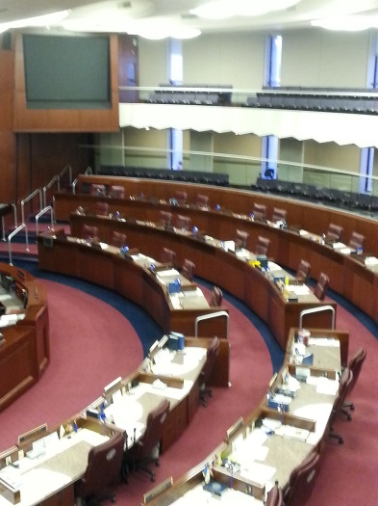
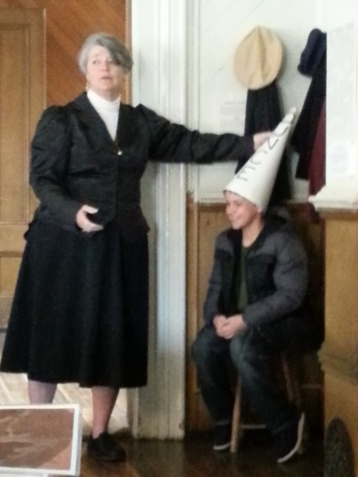
Field Trips: Southern AND Northern Nevada
Carson City
Capital Building
Legislative Building
Stewart Indian School
Nevada State Museum
Southern NV
Ghost Towns
Hoover Dam
Boulder City Park
State Parks
Virginia City
Mines
4th Ward School
Train / Trolley Ride

Slide 11
Parent Communication
Parent conferences in December
Classroom website www.natemack4.weebly.com
E-Mail

Slide 12
Thank You!
Thank you for joining us – please visit the fourth grade hallway during the last session to tour the classrooms and sign in with your email address.

