Slide 1
Welcome to 4th Grade!
Please remember to sign-in.
If you haven’t already sent in your communication form, please sign the e-mail address form.
If possible, take a helping hand.

Slide 2
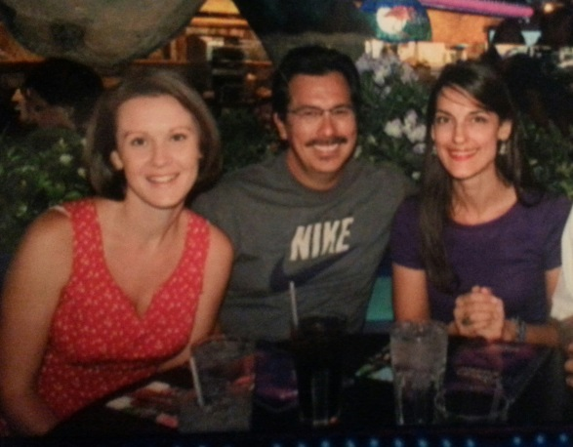

Introduction
Mrs. Hinton
7th year teaching in CCSD
  experience in 3rd, 4th, and 5th grade
5th year teaching at Nate Mack
  4th year in 4th grade
Product of Clark County School District
Mr. Hayden
14th year teaching in CCSD
  experience in 3rd, 4th, and 5th grade
2nd year teaching 4th grade at Nate Mack
Mrs. Rozgay-Miller
8th year teaching in CCSD
8th year teaching 4th grade at Nate Mack

Slide 3
Departmentalization
Mrs. Hinton – Math
Mr. Hayden – Writing and Science
Mrs. Rozgay-Miller – Reading and Social Studies
Each subject is 80 minutes long
Students travel with their homeroom class
Differentiated instruction during homeroom

Slide 4

Curriculum
ELA Focus and Projects
  Literature
  Narrative Writing
  Book Clubs, Response Journals, Readers Theater
  Informational Text – Response Journals
  Writing Informational / Research Papers
  Science: Space Study, Energy Experiments, Body Systems
  Literature and Informational Revisited
  Opinion Writing
  Social Studies: Nevada History, Native American Projects, Salt Maps, Wax Museum

Slide 5

Curriculum
  :
MATHEMATICS
Areas of Focus
Geometry
Place Value
Multi-digit Multiplication
Multi-digit Division
Word Problems
Equivalent Fractions
Comparing Fractions
Multiplying Fractions
Decimals
Measurement

Slide 6
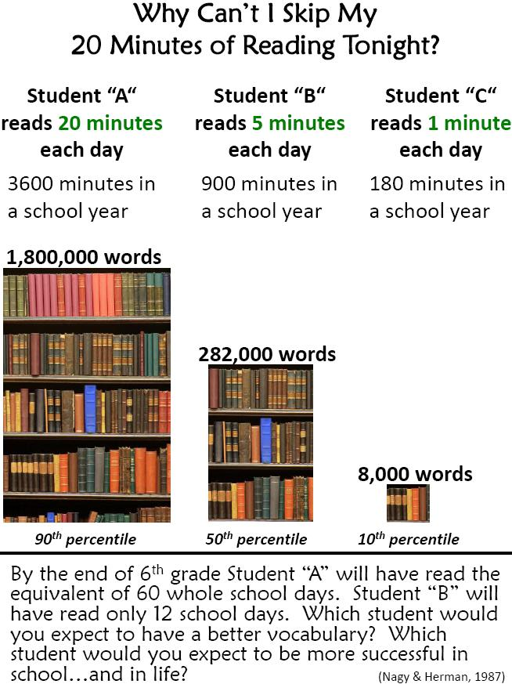
HOMEWORK
Reading homework will consist of nightly reading record in student planners.
Math homework will be assigned nightly and is expected to be turned in the next day in homework journals.
Math homework will consist of a short mixed review and bookwork or a practice sheet.
Math textbooks will be checked out to each student and can be left at home.
Homework assignments will be copied down daily into student planners
Mack Money for completed homework and signed planners
Homework Club Parties
Missing Homework Binder

Slide 7
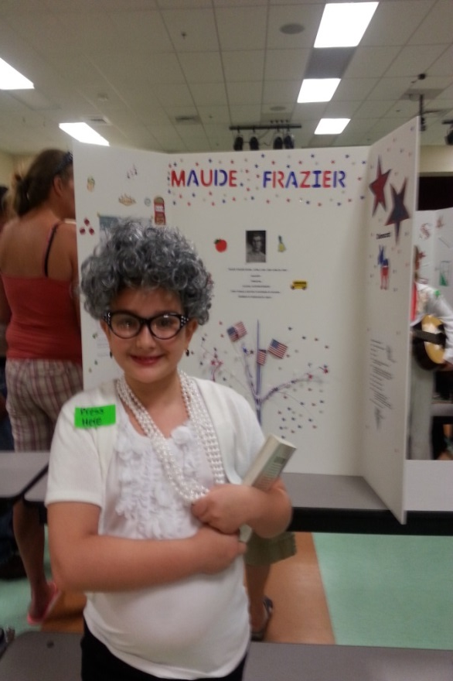
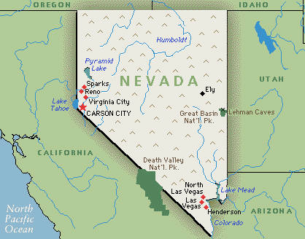
4th Grade Projects
Famous Nevadan
Wax Museum
Native American Projects
Constellation Boxes
Nevada Salt Maps

Slide 8
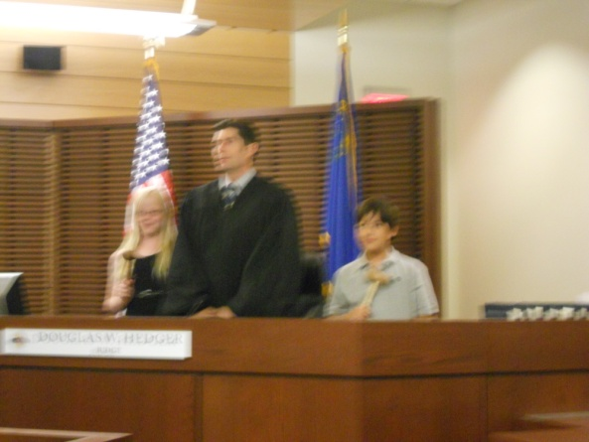
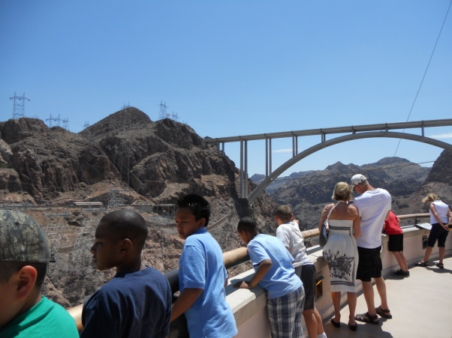
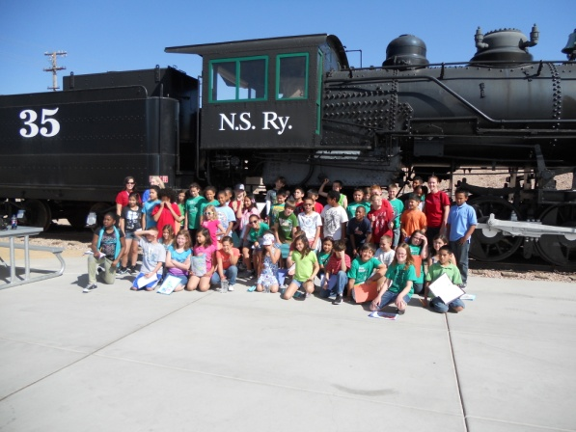
Field Trips: Southern NV
Museums
Courthouse
Hoover Dam
Boulder City Park
Boulder City Train

Slide 9
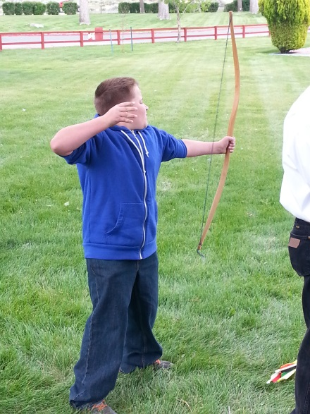
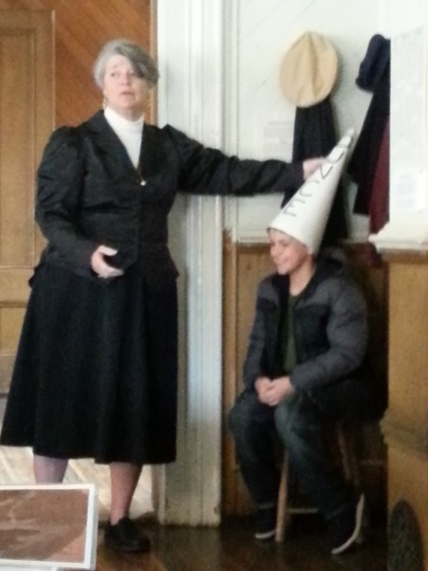
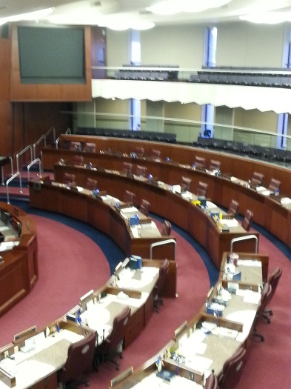
Field Trips: Northern NV
Carson City
Capital Building
Legislative Building
Stewart Indian School
Nevada State Museum
Virginia City
Mines
Piper’s Opera House
4th Ward School
Train / Trolley Ride

Slide 10

Fundraising
Snack Shack
Movie Night
Donations May Include:
Water
Capri Suns
Chips
Fruit Snacks
Candy
Cash Donations for Pizza / other items
Volunteering to work Movie Night

Slide 11
Parent Communication
Student planners
Parent conferences in December
Classroom website www.natemack4.weebly.com
Text @ed47d to (702) 830 – 5412

